Slide 1

Chapter Support Committee:
Leadership Webinar
Chapter Governance + Finance

Slide 2

Orientation Agenda
Welcome and Introductions Saunders
Governance; an Overview Irvin
Roles/Responsibilities Irvin
Governance Structure Irvin
Chapter Finance Nemmer
Questions/Wrap up Saunders

Slide 3
Karen Saunders
Chair, Chapter Support Committee

Slide 4
Chapter Support Committee
Notes:
Introduction of the members (Starts with Karen, Beth Mooney, Tracey, Liz, Nanci, Mary Ann)

Slide 5
Connect with us
1. Virginia (VA1)
2. Volunteer (TN1)
3. Commonwealth (KY1)
4. Southern New Jersey (NJ2)
5. Northern New Jersey (NJ3)
6. DC Metro-Maryland (MD1)
Karen Saunders (Virginia Chapter)
Chairperson
Phone: 804.578-6649
Email: karen.saunders@sai.rehab

Slide 6
Connect with us
1. Arizona (AZ3)
2. Greater Philadelphia (PA1)
3. Southwestern Pennsylvania (PA3)
4. Northeast Pennsylvania (PA4)
5. Northeastern New York (NY2)
6. Baystate (MA1)
Beth Mooney (AZ Chapter)
Phone: 602-647-2553
Email: beth.mooney@encoumpasshealth.com

Slide 7
Connect with us
1. Michigan (MI2)
2. Northern Illinois (IL1)
3. Wisconsin (WI1)
4. Minnesota (MN1)
5. Central Ohio (OH5)
6. Ohio River Valley (OH2)
Tracey Connolly (MI Chapter)
Phone: 313-993-7873
Email: tconnolly@dmc.org

Slide 8
Connect with us
1. Southeast Texas (TX1)
2. Central Texas (TX2)
3. Northeast Texas (TX4)
4. Greater Kansas City (KS2)
5. Central Colorado (CO1)
6. Florida (FL1)
Liz Squires (FL Chapter)
850-251-3911Phone:
Email:
Elizabeth.squires@encompashealth.com

Slide 9
Connect with us
1. Western Michigan (MI3)
2. South Dakota (SD1)
3. Alabama (Al1)
4. Central Carolinas (NC3)
5. Greater North Carolina (NC1)
6. South Carolina (SC1)
7. Delaware (DE1)
Nanci Steinebach (WestMI Chapter)
Phone: 616-318-9576 Cell
Email: nanci.steinebach@maryfreebed.com

Slide 10
Connect with us
1. Los Angeles/Orange County (CA4)
2. La Valle (CA9)
3. Northern California (CA1)
4. Crescent City (LA1)
5. Northwest (WA3)
6. Utah (UT1)
Mary Ann Laslo (Northern CA Chapter)
Board Liaison
Phone: 707-477-5092
Email: maryannlaslo@outlook.com

Slide 11
Committee Goals
Karen Saunders

Slide 12
Gayle Irvin
Executive Director, ARN

Slide 13
Chapter Board Governance
Gayle Irvin, Executive Director

Slide 14
Association Management Center
Association Management Center (AMC) provides full-service management and specialized administrative services to health care professional societies and trade associations.
The AMC model affords association clients the characteristics of economies of scale, experience in the association marketplace, flexibility and adaptability, buying power and centralized facilities.
AMC provides dedicated staff to each of its associations as well as financial management, publishing and editorial services, web and information services support, meeting and event planning, among other services.

Slide 15
Dedicated Staff Structure
Gayle Irvin, MPH CAE, Executive Director
Sara Hynes, Education and Operations Manager
Anastasia Fidati, Marketing and Membership Manager
Ewa Aksamit, Certification Coordinator
Kate Denley, Education Coordinator
Mel Moynihan, Operations Administrator

Slide 16
World of Associations
More that 1.2 million organizations with 501(c) 3 or 6 status designation
Nearly 20% of Americans (63 millions) volunteer through a membership organization
Source: American Society of Association Executives: 2015
Notes:
501 c 3: corporation trust unicorporated assocations that are tax exempt
501 c 6: chambers of commerce trade real estate board professional association pro football leagues board of trades
It’s interesting to note that 26 million people serve on non-profit boards.
Board service is not like other “jobs” in that there are no schools for board training – you are volunteers! On the job training is typical.

Slide 17
Associations are complex
Members are owners
  The association belongs to them
Members are customers
  They are consumers of the value of products, programs and services delivered
Members are the workforce
  Their participation, energy and commitment to accomplish work contribute to the organization’s ability to deliver value
Source: The Will to Govern Well, ASAE, 2002

Slide 18
Introductions
What’s one thing you hope to learn from today’s meeting?

Slide 19
EXCEPTIONAL Governance
Roles and Responsibilities of Chapter Board members
Good Governance
ARN Governance structure

Slide 20
ARN Organizational Structure
ARN Board of Directors
Executive Director
(Management Team)
Board Committees
Budget & Finance
Nominating & Leadership Development
Governance Task Force
Committees
Awards
CEPU
Chapter Support
Conference Planning
Health Policy
Newsletter
Products & Programs
Research
Scholarship
Executive
Committee
Rehabilitation Nursing Certification Board (RNCB)
Rehabilitation Nursing Foundation Board of Trustees
CRRN Exam Committee
CRRN Item Development Committee
CRRN Audit Committee

Slide 21
What does the Chapter Board do?
Notes:
Responsibilities

Slide 22
Board Structure
President
President-Elect
Treasurer/Secretary
Director
Notes:
ARN’s structure - “sticky” and can be determined

Slide 23
Role of the Chapter Board
Determine mission, vision and strategies.
Ensure and allocate resources.
Provide financial oversight.
Make wise and consequential decisions.
Support and evaluate the executive director.
Ambassador – voice of the organization’s mission, primary advocates for ARN on a local level.
Notes:
To govern means defining the vision, values, and strategic direction of the organization. Also governing means to set policy.
The board makes decisions and allocates resources to support strategic priorities.
If you think about it, the board has relatively little time together. So focusing on consequential decisions, rather than minor matters is the best use of your time and they best way to support the goals of ARN.
Finally, obviously, we are all ambassadors for ARN.
We’ll talk more about some specific responsibilities of the board a little later.

Slide 24
What is Good Governance?
Govern in a manner that is consistent with the Academy’s stated shared values and the goals identified within its strategic plan
Understand the needs, wants and values of the broader membership
Ensure effective organizational planning and adequate resources (structure, funds, time, volunteers, staff, technology, etc.)
Ensure legal and ethical integrity and maintain accountability
Determine, monitor and enhance programs, products and services
Partner with staff to communicate, assess and measure progress
Notes:
Governance is defined as “what Boards must do to advance strategy

Slide 25
Parliamentary Procedure
Flexible, but adhering to principles
Quorum (majority of board members – 6)
required for decision-making, so your participation is important. Inform of absence in advance.
Thorough deliberation ensures the best decision-making
  Healthy conflict is encouraged
Decisions are reached by consensus
Notes:
If you’ve ever witnessed a House of Delegates, you would see Parliamentary procedures in earnest. I would categorize our practice as flexible. We do follow a motion procedure that needs to be seconded, discussion and deliberation to follow, and final vote to be taken. However, you do not need to be “recognized” by the chair before being able to speak. We call this “flexible” parliamentary procedure.
In regard to deliberation, productive conflict is a necessary component of effective small group decision making. “Boards that agree on everything are doing it wrong.”
As Board chair, I take the responsibility of entertaining all opinions on issues and then in a collaborative manner, facilitate reaching mutual understanding before leaving the room. Destructive conflict surfaces when issues are left unresolved, or not recognized.

Slide 26
In a Knowledge-based Organization
Who makes the decision is far less important than the quality of information and insight on which the decision is made.
Source: The Will to Govern Well, ASAE, 2002
Notes:
As we begin our 2020 Strategic Planning process this is important to remember. to be an effective board, its so important to consider all information.

Slide 27
BOARD FATIGUE

Slide 28
How the Chapter Board should work together
Developing agenda
Preparation of board materials
Parliamentary procedure – Flexible!
Preparation and participation by board members
Communication between meetings – Chapter Meetings
Knowledge-based decision making

Slide 29
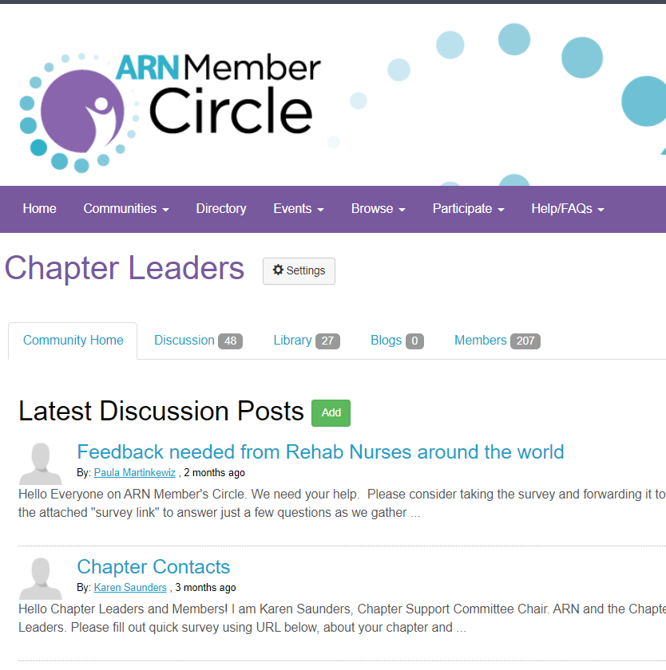
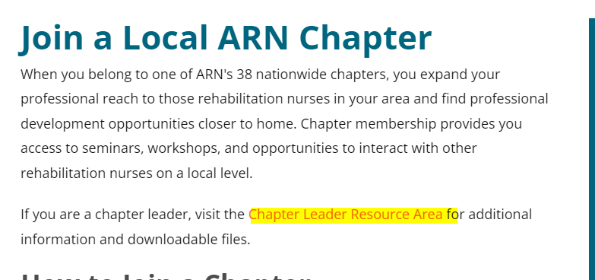
Resources
Notes:
The Board uses the ARN online member community as a hub of information so Board members have regular access to numerous documents – the Strategic Plan, key policies, Bylaws and tax documents, meeting agendas materials and minutes, orientation documents, and development articles for Board members.
You have already received access to the community.

Slide 30
2022-2025
Strategic Plan

Slide 31
ENGAGEMENT
  Engage members and other stakeholders to advance ARN’s mission
  Expand leadership development initiatives to advance committed, high-quality, diverse, future leaders
  Expand services and value add offerings
  Understand and define areas of practice in the rehabilitation profession and develop value propositions that align with needs across career stages/functions
  Expand opportunities for expanding the conversation regarding diversity, equity and inclusion within ARN and amongst its board, committees and member communities
VISIBILITY
Define and position ARN as the leader of evidence-based rehabilitation nursing, education, and practice
Champion excellence in the rehabilitation nurse workforce
KNOWLEDGE & PRACTICE
Advance the science and art of rehabilitation nursing through content that is based on research, evidence, and advocacy
Promote research through financial and educational initiatives
Facilitate evidence-based practice through innovative educational offerings
Serve as the primary rehabilitation nursing source for legislation, policy formation, regulatory initiatives, and guideline development
Advance sustainable growth through the integration of a mission-aligned business model

Slide 32
What does this all mean?
You have a significant role in supporting ARN’s growth and development
Everyone's voice and perspective is needed

Slide 33
What’s your experience?
What is something you bring to this board experience you’d like to share?
Notes:
Chat only
If you’ve ever witnessed a House of Delegates, you would see Parliamentary procedures in earnest. I would categorize our practice as flexible. We do follow a motion procedure that needs to be seconded, discussion and deliberation to follow, and final vote to be taken. However, you do not need to be “recognized” by the chair before being able to speak. We call this “flexible” parliamentary procedure.
In regard to deliberation, productive conflict is a necessary component of effective small group decision making. “Boards that agree on everything are doing it wrong.”
As Board chair, I take the responsibility of entertaining all opinions on issues and then in a collaborative manner, facilitate reaching mutual understanding before leaving the room. Destructive conflict surfaces when issues are left unresolved, or not recognized.

Slide 34
Chapter Webinar
Annual Financial Reporting
Julie Nemmer, Finance

Slide 35
Julie Nemmer
Director of Finance, ARN

Slide 36

ARN Annual Financial Reporting
Objectives
  Understand Purpose of Financial Reporting
  Overview of Financial Reporting Templates
  Submit Timely and Accurate Data
  Compliance to Federate and State Laws

Slide 37

Understand Purpose of Financial Reporting
Responsibility to Members and Donors
Focus on directing funds to support / fulfill our mission
Protect tax exemption status
Notes:
Maintain financial accountability of organization, act as trustee of assets and exercise due diligence. Well managed financial policies are sound.
All chapters have EIN that should be established when they are formed. Chapters are exempt as 501c6 organizations under and ARN group exemption

Slide 38
Start by Building a Budget
A budget is a plan for the year
Plans change – be flexible and realistic
Board should approve the budget
Notes:
A budget is your plan for the year – how much money do we have and what are we going to spend it on
Plans can change as needed throughout the year – be realistic and flexible
Simple excel document with income and expenses – we can share the example if they want
Should include year before actuals – use as reasonableness check – understand large variances from prior year
Board should approve budget each year – the budget is an important control

Slide 39
Overview of Financial Reporting
Begins with Good Recordkeeping
  Tracking Deposits (Revenue) and Disbursements (Expenses)
  Reconciling monthly Bank Statement
  Obtaining IRS Form W-9 Request for Tax ID at
  time disbursements are made to Vendors

Slide 40
Reporting to Membership
Notes:
Board should know where income comes from and how that income is being spent
Simple pie charts for current year – compare against budget
Bar chart for comparison
Could also include net assets – how much money you have in the bank account
Most important is just how you are doing and report that back to members
ARN’s board members like the visuals – can share examples
Can also use format of annual compliance reports we will review later.

Slide 41
Chapter Boards Have a Fiduciary Duty
Responsibility to members, exhibitors, advertisers, sponsors and other funding groups.
Focus on directing funds to support / fulfill our mission
Treasurer’s role is to help the board fulfill their fiduciary responsibilities
Notes:
As Treasurer of a chapter, you have a fiduciary responsibility to act in the best interest of the chapter
In addition to tracking and managing the expenses you along with the other board members should make sure chapter money is spent in alignment with your mission which should be outlined in your bylaws
For example make sure your funds are spent on the items approved in your budget & communicated with other board members and members of the chapter

Slide 42
Overview of Financial Reporting Templates
Chapter Annual Report Forms Instructions
    IRS Form W-9 Request for Tax ID
    IRS Form 1099 – Miscellaneous
    End of year Financial Reports
      Balance Sheet
      Income Statement
      Federal 990 Details
      Unrelated Business Income Tax Worksheet
Notes:
ARN requires certain compliance reporting to help the chapters comply with IRS regulations

Slide 43
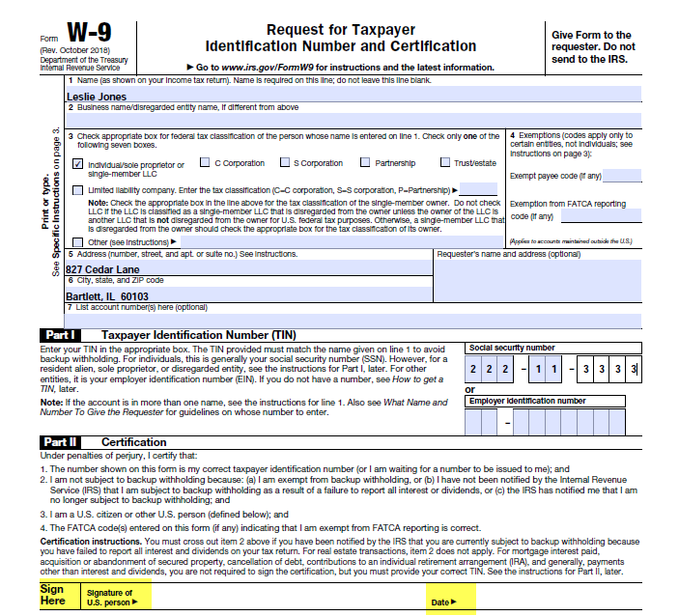
Objective:
Overview of Financial Reporting Templates
Notes:
Important to get W-9s from vendors you pay for services, awards ,etc. This is an IRS requirement for all vendors but very important for those we pay for services due to 1099 reporting

Slide 44

Objective:
Overview of Financial Reporting Templates
IRS Form 1099-NEC
  U.S. Individuals or Businesses that are given payment for taxable services (Expenses) greater than $600 within a specific calendar year
    Independent Contractors
    Award and Scholarship Recipients
    Donations and Contributions
Notes:
Need to report to the individual and the IRS. ARN will do this for you but you have to provide info

Slide 45
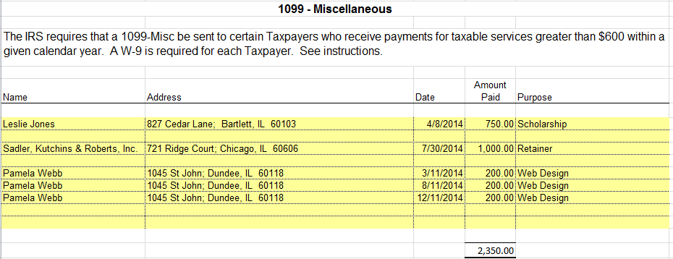
Objective:
Overview of Financial Reporting Templates
Notes:
1099- MISC or 1099-NEC

Slide 46

Objective:
Submit Timely and Accurate Data
IRS Form 1099
  Important Deadlines!
    Due to ARN National Office by mid-January
      Tax document due to the Individual/Business - Postmarked by January 31st
      Tax document due to the IRS – by February 28th

Slide 47

Objective:
Overview of Financial Reporting Templates
Balance Sheet
  Reports financial position as of December 31st
    Assets
    Liabilities
    Chapter Equity
Notes:
Have not used these the last few years because information was inaccurate. Tried accumulating information from the bank statements but difficult. Input on going back to this? Simplify?

Slide 48
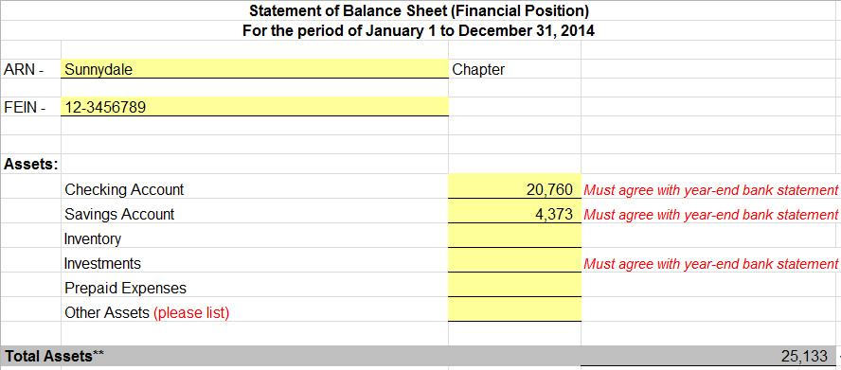
Objective:
Overview of Financial Reporting Templates
Assets
Notes:
Assets – everything owned– mostly bank accounts
All accounts should be in name of chapter not individual – should have transparency on payments – dual signatures, review of reconciliations, check registers, etc.

Slide 49
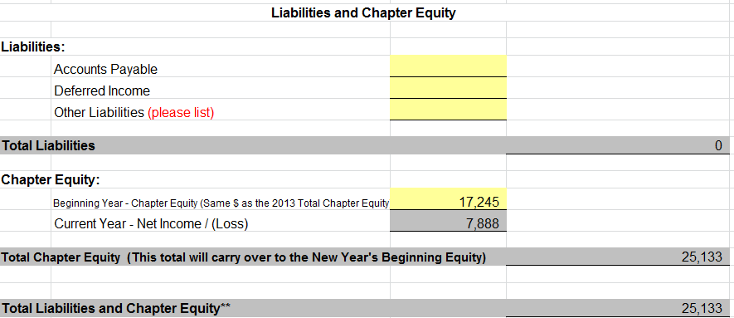
Objective:
Overview of Financial Reporting Templates
Liabilities and Chapter Equity
Notes:
Liabilities – what you owe
Equity is the earnings since beginning of time – increases annually with profit/decrease with loss

Slide 50

Objective:
Overview of Financial Reporting Templates
Income Statement
  Reports profitability for the calendar year
    Revenues
    Expenses
    Net Income / (Loss)

Slide 51
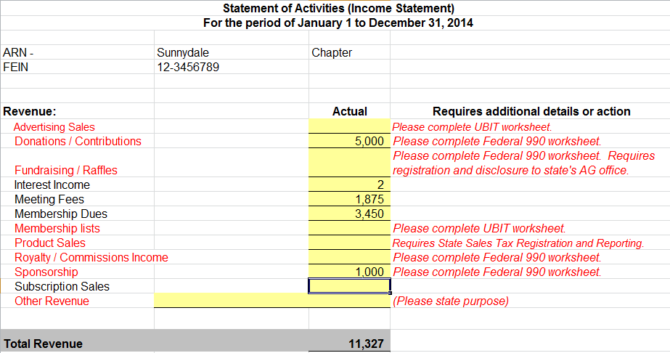
Objective:
Overview of Financial Reporting Templates
Total Revenue
Notes:
Detail of revenue earned -

Slide 52
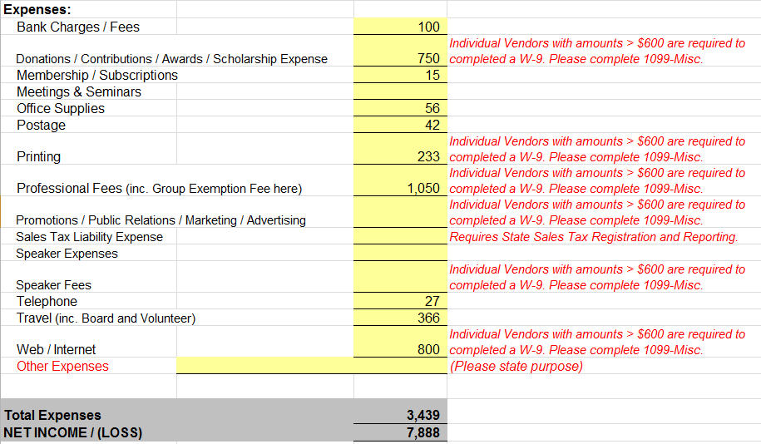
Objective:
Overview of Financial Reporting Templates
Total Expenses

Slide 53
Objective:
Submit Timely and Accurate Data
Financial Reports
  Important Deadlines!
    Due to ARN National Office by late February/early March
    Group Tax Return due to the IRS by May 15th
Notes:
The past few years have asked for bank statements – still don’t have all. Extension has been filed but still need information
In future go back to templates? Financial reporting is important – need to report internally and to national

Slide 54
Objective:
Compliance to Federal and State Laws
501(c)(6) – Organizations
An association of persons having some common business interest, the purpose of which is to promote such common interest and not to engage in a regular business ordinarily carried on for profit. No part of the business’ net earnings may inure to the benefit of any private shareholder or individual and it may not be organized for profit to engage in an activity ordinarily carried on for profit.
Notes:
Exempt under group exemption

Slide 55
Objective:
Compliance to Federal and State Laws
Fundraising, Raffles and Donations
  Local State laws require registration prior to event and annual reporting.
  Sales Tax
  Local State laws require registration prior to first sale, annual reporting and payment of a tax liability.
  Laws vary by state. Non-compliance is illegal!

Slide 56
Key areas of Financial Management
Accountability
Tax exempt status
Budget and spending
Controls
Financial reporting
Notes:
The key areas of financial management are:
Accountability – making sure the chapter funds are utilized in ways that support the chapter members and align with bylaws
Maintain your tax exempt status under ARN – this means making sure your complete your yearly compliance report with ARN National office so they can file your taxes
Creating a budget each year and tracking your spending, monthly records keeping to make sure you are financially sound and following your budget
Make sure you have some sort of controls in place, the bank account should be under the chapter name and have at least two signers the president and secretary treasurer who both have access to online banking, statements etc
Report out to your members at least once a year, can be a simple email just letting them know how their dues were used and the financial state of the chapter

Slide 57
Data Security
All Chapter Leaders should be aware of the sensitivity of data collected from individuals (ie Social Security Numbers). All have the responsibility of keeping an individual's personal data confidential and protected.
Notes:
Responsibly purge data

Slide 58
Mary Ann Laslo
Chapter Support Board Liaison

Slide 59
We hear you!

Slide 60
Suggestions to alleviate workloads on the board
Establishing expectations from the board
Establishing processes
Onboarding
Having permission for delegating work
Open communication
Resources

Slide 61
Questions?

Slide 62
Connect with us
1. Arizona (AZ3)
2. Greater Philadelphia (PA1)
3. Southwestern Pennsylvania (PA3)
4. Northeast Pennsylvania (PA4)
5. Northeastern New York (NY2)
6. Baystate (MA1)
Beth Mooney (AZ Chapter)
Phone: 602-647-2553
Email: beth.mooney@encoumpasshealth.com

Slide 63
Connect with us
1. Virginia (VA1)
2. Volunteer (TN1)
3. Commonwealth (KY1)
4. Southern New Jersey (NJ2)
5. Northern New Jersey (NJ3)
6. DC Metro-Maryland (MD1)
Karen Saunders (Virginia Chapter)
Chairperson
Phone: 804.578-6649
Email: karen.saunders@sai.rehab

Slide 64
Connect with us
1. Michigan (MI2)
2. Northern Illinois (IL1)
3. Wisconsin (WI1)
4. Minnesota (MN1)
5. Central Ohio (OH5)
6. Ohio River Valley (OH2)
Tracey Connolly (MI Chapter)
Phone: 313-993-7873
Email: tconnolly@dmc.org

Slide 65
Connect with us
1. Los Angeles/Orange County (CA4)
2. La Valle (CA9)
3. Northern California (CA1)
4. Crescent City (LA1)
5. Northwest (WA3)
6. Utah (UT1)
Mary Ann Laslo (CA Chapter)
Board Liaison
Phone: 707-477-5092
Email: maryannlaslo@outlook.com

Slide 66
Connect with us
1. Southeast Texas (TX1)
2. Central Texas (TX2)
3. Northeast Texas (TX4)
4. Greater Kansas City (KS2)
5. Central Colorado (CO1)
6. Florida (FL1)
Liz Squires (PA Chapter)
850-251-3911Phone:
Email:
Elizabeth.squires@encompashealth.com

Slide 67
Connect with us
1. Western Michigan (MI3)
2. South Dakota (SD1)
3. Alabama (Al1)
4. Central Carolinas (NC3)
5. Greater North Carolina (NC1)
6. South Carolina (SC1)
7. Delaware (DE1)
Nanci Steinebach (WestMI Chapter)
Phone: 616-318-9576 Cell
Email: nanci.steinebach@maryfreebed.com

