Slide 1
Updated ARN Competency Model for Professional Rehabilitation Nursing- Practice Applications
Jill Rye DNP, RN,CRRN, CNL, FARN Stephanie Vaughn PhD, RN, CRRN, FAHA, FARN

Slide 2
ANCC Accreditation Statement
The Association of Rehabilitation Nurses (ARN) is accredited as a provider of nursing continuing professional development by the American Nurses Credentialing Center’s Commission on Accreditation.

Slide 3
Speaker Disclosure Statement
Jill Rye DNP, RN,CRRN, CNL, FARN - Clinical Nurse Leader, Avera McKennan Hospital, Sioux Fall, SD
Stephanie Vaughn PhD, RN, CRRN, FAHA, FARN – Professor Emeritus, California State University, Fullerton Clinical Nurse Specialist, Encompass Health Rehabilitation Hospital of Tustin (CA)
No off-label use will be discussed.
Stephanie Vaughn is a member of International Continence Expert Forum (ICEF) – Hollister, Inc.

Slide 4
Learning Outcomes
Describe the ARN Competency Model
Discuss Task Force strategies for review of the Model and identify key revisions made to the Model
State outcomes/implications for professional rehabilitation nursing practice within an intra/interprofessional team.

Slide 5
Why a Competency Model?
Rehabilitation nursing is a specialty of managing and promoting care of persons with disability and chronic health conditions along the healthcare continuum (ARN, n.d.)
Nursing models provide a lens through which rehabilitation nurses can view their practice and guide it
The Competency Model for Professional Rehabilitation Nursing provides an organized framework to foster best practices through its application

Slide 6
Definitions
Domain – specific sphere of knowledge
Four original domains were created that highlight essential role competencies needed for practicing rehabilitation nurses – these remain
Competency is a behavior (includes activities and informed by knowledge and skills)
Competencies were further delineated into three levels of nurse proficiency reflecting degree of accountability and/or autonomy:
beginner
intermediate (CRRN)
Advanced (expert resource; roles may include but not be limited to educator, CNS,NP, etc.).

Slide 7
The Task force
An eight member task force was selected to represent different geographic regions of the US and various clinical and academic settings
The TF reviewed and revised the current Model to reflect current practice and to ensure the Model stays relevant as we move into the second decade of the 21st century

Slide 8
The Appraisal process
Task force met via Zoom throughout 2020 at one-two month intervals
Following an initial review of the Model by all members, the group was divided into two- person subgroups and assigned one of the four domains and its associated competencies for an in-depth appraisal
Each subgroup also developed a case story that tells a “real life” scenario to highlight the domain principles and competencies

Slide 9
The Appraisal process (cont.)
After initial revisions were agreed upon, the domain and case story was assigned to a second subgroup for ongoing appraisal
When TF reconvened, the four domains and case stories were discussed until consensus achieved

Slide 10
Revision Outcomes
Words do matter! Client changed to patient to be more inclusive, as persons with disability need healthcare and treatment in partnership with professionals
Family definition also modified to include any person who provides support and/or care to the patient
Rehabilitation nurses – strong advocates for patient and family and acknowledge social conditions that may influence access to the right setting and care quality

Slide 11
Revision Outcomes (cont.)
Added competency 1.4 to Domain one that focuses on the understanding of the worldview of individuals reflecting rehabilitation nursing’s multicultural approach and global reach
Congruent with ARN strategic plan that purports rehab nursing is inclusive, non-biased, and culturally sensitive. Concept threaded across domains/competencies

Slide 12
Revision Outcomes (cont.)
Model represents the culturally sensitive and holistic nature of rehabilitation nursing practice, with interprofessional collaboration to promote patient-family and community health
Added the word intraprofessional throughout the Model; reflects nurse peer collaboration and feedback process integral to professional nursing practice

Slide 13
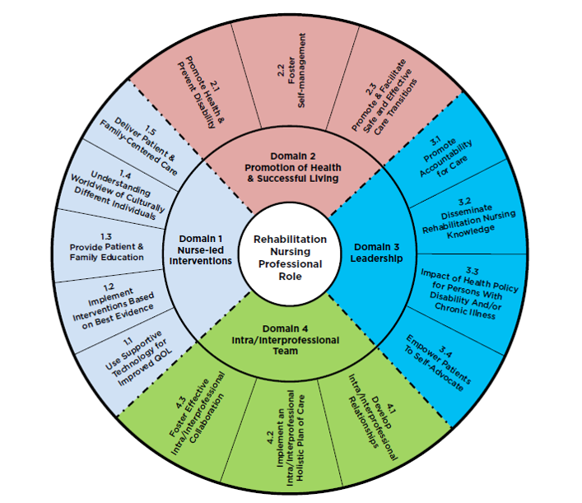
ARN Competency Model for Professional Rehabilitation Nursing

Slide 14
Domain 1: Nurse-led Evidence-based Interventions to Promote Function and Health Management in Persons with Disability and/or Chronic Illness
1.1 Use Supportive Technology for Improving Quality of Life for Persons with Disability
1.2 Implement Nursing and Inter-professional Interventions Based on Best Evidence to Manage the Patient’s Disability and/or Chronic Illness
1.3 Provide Patient-Family Education in Relation to Disability, Chronic Illness, and Health Management (DCIHM)
1.4 Understanding Worldview of Culturally Different Individuals
1.5 Deliver Patient - Family-centered Care

Slide 15
Domain 2: Promotion of Health and Successful Living in Persons with Disability or Chronic Illness Across Life-span
2.1 Promote Health & Prevent Disability Across the Life-span
2.2 Foster Self-Management
2.3 Promote and Facilitate Safe and Effective Care Transitions

Slide 16
Domain 3: Leadership
3.1 Promote Accountability for Care
3.2 Disseminate Rehabilitation Nursing Knowledge
3.3 Impact Health Policy for Persons with Disability and/or Chronic Illness
3.4 Empower Patient Self-Advocacy

Slide 17
Domain 4: Intra/Interprofessional Teams
4.1 Develop Intra/Interprofessional Relationships
4.2 Implement an Intra/Interprofessional Holistic Plan of Care
4.3 Foster Effective Intra/Interprofessional Collaboration
Competency 1.4 - Understanding Worldview of Culturally Different Individuals Table for Proficiency Levels & Descriptors – next slide

Slide 18
Beginner | Intermediate | Advanced
Participates in the process to become aware of emotional reactions and any tendency to view ethnic, racial, or any other oppressed groups in ways that may negatively impact nursing care | Recognizes and understands how culture, ethnicity, and race may impact rehabilitation care approaches and outcomes | Advocates and becomes actively involved with ethnically and racially diverse patient-families or any oppressed groups in and out of the workplace
Demonstrates caring competence in showing an awareness of how stereotypic attitudes and preconceived ideas affect any oppressed group | Seeks further knowledge, including relevant research evidence, for ways to adapt personal views to reflect greater respect for the worldviews of persons from other cultures in caring for patients-families | Applies current relevant valid and reliable research evidence that affects various underrepresented groups when designing or providing and evaluating care

Slide 19
Case Story
45 yo Maria Hernandez, a small business owner and avid bicyclist, was struck by an auto and injured during a weekend ride, resulting in a SCI at the T-12 level. After medical stabilization, Maria was transferred to acute rehabilitation. Admission orders included a neurogenic bladder plan. The nurse approached her early in her stay regarding self-cath program and provided education regarding neurogenic bladder function. Maria politely refused stating she would not need to catheterize as she would regain bladder function shortly! Concerned, Maria’s nurse consulted the CNS as to how to proceed. She recommended the following strategies:

Slide 20
Case Story (cont.)
Approach Maria in a positive manner; acknowledge her denial and fear related to this life-changing event
Consult with other IP team members as indicated for support (i.e. PT re: positioning aids, CNS regarding cath choices)
Provide step by step instructions as the nurse performs the procedure
Explain the bladder plan simply in a matter of fact manner, providing simple educational materials with diagrams and pictures
Collaborate with the OT regarding a specialized mirror that can assist Maria with visualization and facilitate self-cath
Attempt to have Maria participate in the self-cath each day “walking her through procedure each step of the way”

Slide 21
Case Story (cont.)
After a few days of assisted practice; set up the supplies on the over bed table and have her attempt procedure providing positive reinforcement Maria was successful after several tries, which appeared to boost her confidence
The nurse, CNS, and OT also had her initiate the cath procedure while in the wheelchair in the bathroom assisting her with clothing management and leg positioning
Maria was discharged to home and was independent with her bladder program using a discreet hydrophilic cath product
CNS followed up via Zoom. Maria was also referred to Home Health for PT/OT. Maria was provided with community resources including a community and web-based support group

Slide 22
Case Story (cont.)
Which competencies were demonstrated in the above scenario?
1.1, 1.2, 1.3, 1.4, 2.1, 2.2, 2.3, 3.2, 3.4, 4.3

Slide 23
Clinical Relevance
The updated Competency Model for Professional Rehabilitation Nursing provides:
A unique structure in which rehabilitation nurses practice at various levels of proficiency in different settings across continuum
Insight into current practice and the advancement of our specialty practice

Slide 24
Clinical Relevance (cont.)
Application for Model utilization include:
Map for educational and clinical practice (i.e. educational needs assessment; framework for academic , staff orientation/onboarding, CEU course, or clinical ladder programs based on proficiency levels; template for recruitment; role description/delineation on IP teams)
Integrated into the ARN educational materials:
Core Curriculum, webinars, conference and/or publications
Various teaching scenarios are available of the ARN website – rehabnurse.org

Slide 25
Conclusion
Rehabilitation nursing has evolved and encompasses nursing in various settings across healthcare continuum
Unites the global rehabilitation nurse community through clarification of roles at different proficiency levels

Slide 26
Jill.rye@avera.org
svaughn@fullerton.edu

